Slide 1
B399: Business & Society
Individual Exercise(25 points):
The Source of Your
Personal Ethical Code or Witnessed Ethical Event

Slide 2
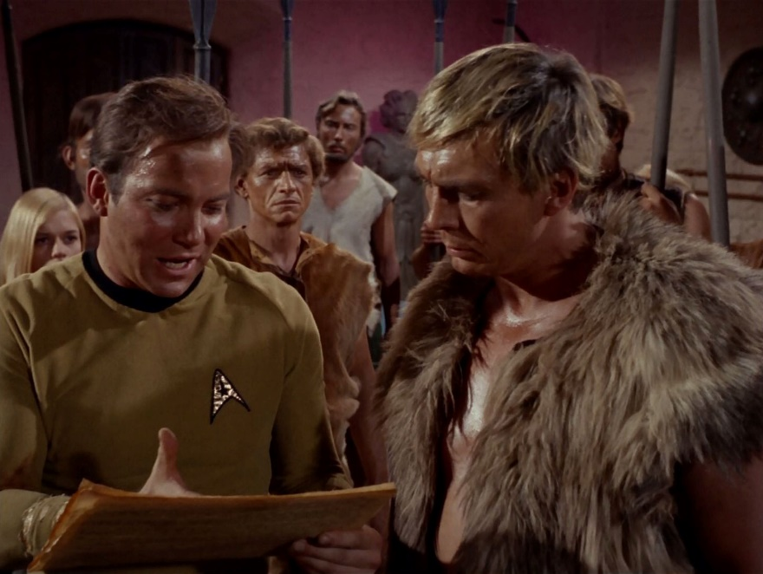
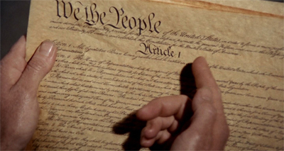
What Has Shaped or Influenced My Ethical or Moral Viewpoint?
Star Trek—The Omega Glory (broadcast March 1, 1968 / season 2) (I was almost 7 years old):
  Omega IV’s Parallel Development:
    Yangs and Kohms
    Kirk looks over the ancient, crumbling document, which appears to be a distorted version of the American Constitution.
    Kirk finishes the sacred speech (the Preamble to the United States Constitution) and rebukes the Yangs’ leader for failing to apply its words to “everyone.”

Slide 3
What Has Shaped or Influenced My Ethical or Moral Viewpoint?
Captain James T. Kirk: These words “. . . must apply to everyone or they mean nothing. Do you understand?”
https://www.youtube.com/watch?v=3bYkNptOJns
Preamble: We the People of the United States, in Order to form a more perfect Union, establish Justice, insure domestic Tranquility, provide for the common defense, promote the general Welfare, and secure the Blessings of Liberty to ourselves and our Posterity, do ordain and establish this Constitution for the United States of America.
My Ethical Story: Indiana’s attempt to treat taxpayers differently based on sexual orientation.

Slide 4
What Has Shaped or Influenced Your Ethical or Moral Viewpoint?
The Assignment—Five Parts:
  Describe either:
      A past ethical dilemma you directly witnessed and that shaped your present ethical code,
      OR
      An ethical dilemma you witnessed at work, school, or other venue that you thought was resolved in a good or ethical manner.
  Your description should tell a story that gives you a good feeling, gives you satisfaction, touches your heart, or makes you feel good.
  The event does not necessarily have to involve a grand ethical dilemma. It could be something as simple as, for example, people refraining from having a loud conversation during an instructor’s explanation of an assignment. This is a habit of expected social behavior and, therefore, exhibits ethics—that is, how people treat each other.

Slide 5
The Assignment—Five Parts (continued):
  Identify the “good” in your ethical dilemma description.
    Describe and analyze how you define the good and why you know it is good.
    Provide a set of principles explaining why what you think, know, or feel is good in your description is in fact good.
  Raise an objection to the good that you identified in Number 2, above, as well as an objection to the analysis and principles you identified in Number 2.
    In other words, why could the good that you identified in your ethical dilemma description actually be bad.

Slide 6
The Assignment—Five Parts (continued):
  In light of the objection you identified in Number 3, above, why is your analysis or the principles identified in Number 2 still compelling to you?
    In other words, why does the good you identified still remain good despite your objection to it.
  Presentation: On the assignment’s due date and during the classes that follow, students will present their essays to the class. I will also share their essays on the class Canvas site.
Your typed essay must contain parts 1-4 as topic headings so that I know which portion of your essay pertains to which part.
(1)
Aristotle term for the judgment or wisdom (i.e., experience) relevant to selecting which virtue applies in a particular situation.
    Why: Phronesis:
Submission: You will submit a hardcopy to grade and an electronic copy to share with the class. Submit to awswain@iusb.edu AND not via Canvas. Your email submission must identify your class’s start time in the subject line to facilitate my sorting.

Slide 7
Questions???

Slide 8
Andrew W. Swain, J.D., LL.M., CFE, CFCI
Assistant Professor
Judd Leighton School of Business & Economics
Indiana University – South Bend
  The lectures and written materials presented in this course are not intended as legal advice. For case-specific advice and particular application of the law, consult a lawyer.

